Slide 1
Evolving Arabic Sentiment Analysis Machine Learning-Driven Methodologies
Natural Language Processing - 1905380
Done by : Anas Mousa 0212567
Khaled Al Shrouf 0215106
Osama Khandaqgee 0213612
Ahmad Allhham 0215697
Dr. Mohammad A. M. Abushariah

Slide 2

Introduction
problem
Aim
Challenges in manually analyzing Arabic text reviews due to the language's complexity and high data volume.
To develop an automated system using machine learning to efficiently categorize sentiments in Arabic reviews.

Slide 3
Objective
Develop Automation: Build a system to automate sentiment analysis of Arabic text reviews.
Handle Complexity: Address linguistic challenges specific to Arabic, including morphology and text directionality.
Improve Accuracy: Apply advanced machine learning models to enhance accuracy in sentiment categorization.
Facilitate Decision-Making: Provide stakeholders with actionable insights to improve customer satisfaction.
Scale Analysis: Enable processing of large volumes of data efficiently, surpassing manual analysis capabilities.

Slide 4
Related Works
A Systematic Literature
Review (SLR)
Arabic Sentiment Analysis
of YouTube Comments
Toward Qualitative
Evaluation of Embeddings
for Arabic Sentiment Analysis
This study was conducted to propose protocols for evaluating embeddings specifically for Arabic Sentiment Analysis (ASA)
The researchers evaluated the embeddings using a neural architecture based on the Convolutional Neural Network (CNN), and the experiments provided excellent results with 91.9% accuracy.
The findings of the review highlight limitations in
existing approaches to ASA, particularly in
preprocessing, feature generation, and sentiment
classification methods. This suggests areas where
future research can focus on improvement.
The researchers found that the
Naïve Bayes algorithm provided
the highest performance, Whereas
the Decision Tree algorithm
provided the lowest performance.

Slide 5
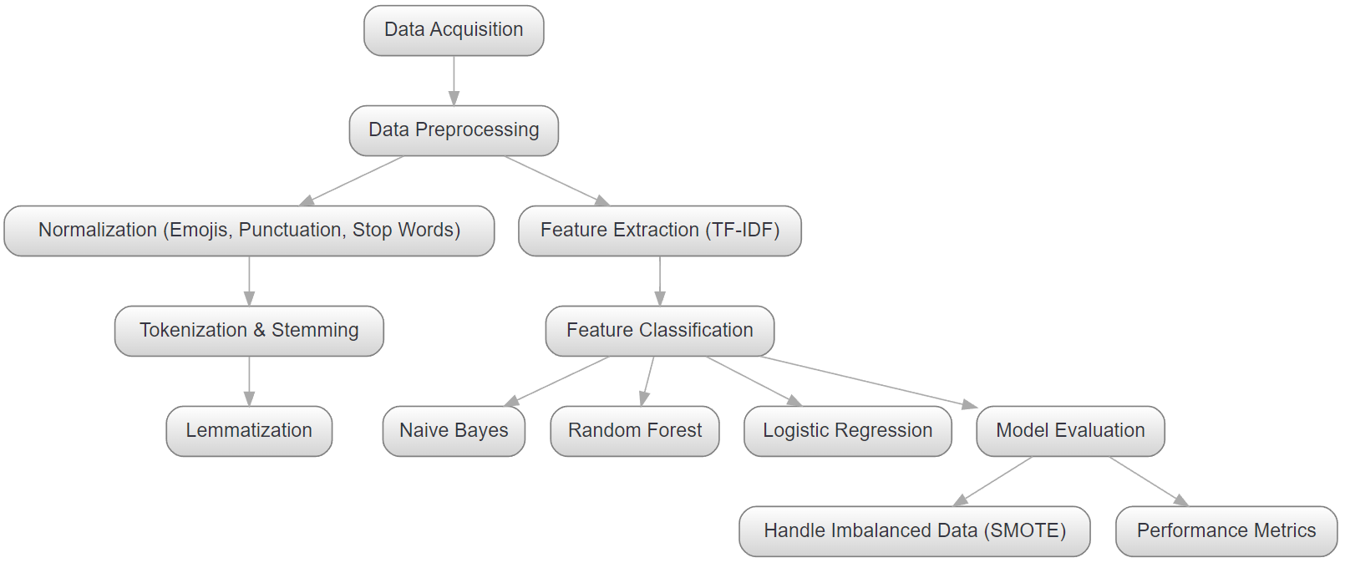
Our pipeline

Slide 6
Data acquisition
Source: Obtained from Kaggle.
Content: Contains reviews from various companies in Arabic language.
Features:
Review Description: Text of the review.
Rating: Categorized as 1 (positive), 0 (neutral), or -1 (negative).
Company: Identifies the company being reviewed.
Volume: Consists of 40,046 review samples.

Slide 7
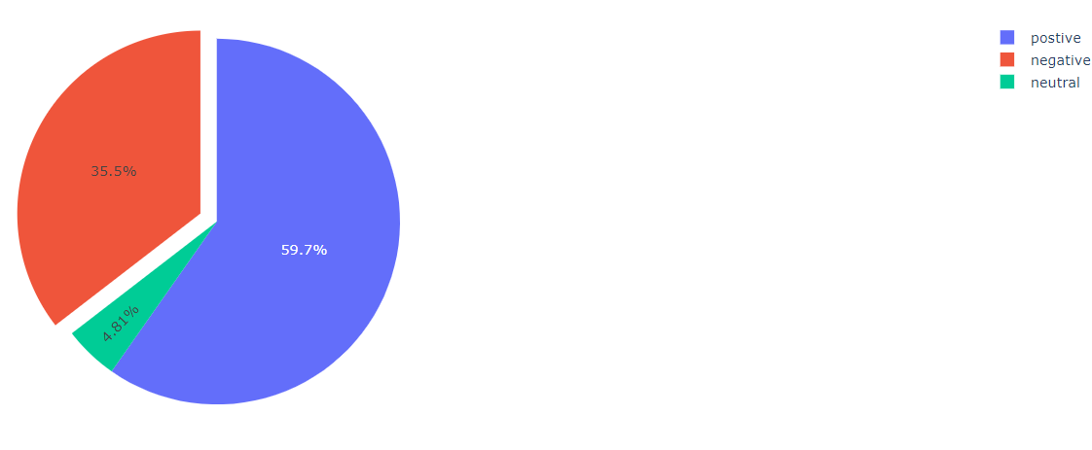
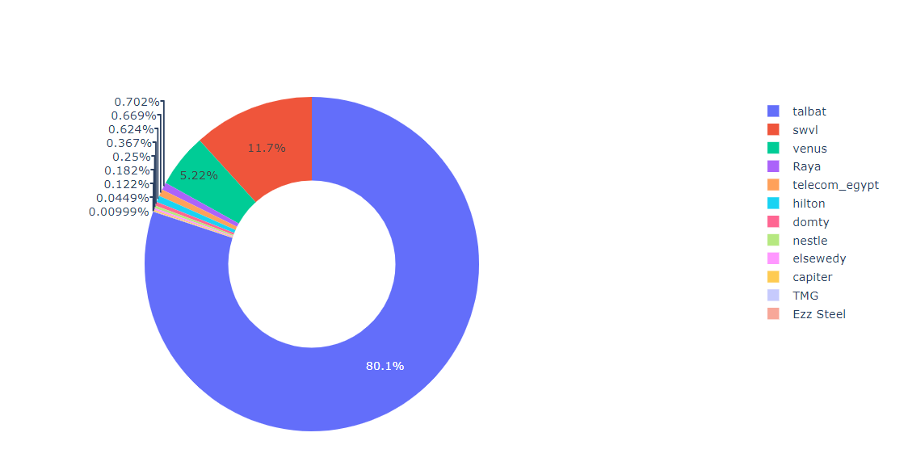
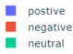
Dataset
sentiment distribution within the dataset:
Company Distribution:

Slide 8

Word Cloud Analysis
To better understand the most common words used in the Arabic text data, we generated a word cloud, a visual representation of text data where the size of each word indicates its frequency or importance within the dataset.

Slide 9
Data Preprocessing
Drop the null values : ensures that the model doesn't process empty inputs.
Remove duplicate entries : can introduce bias and affect the model's generalization capabilities.
Remove emojis : they are often not handled by typical text processing methods
جائع جدا😋😋😋😋😋😋😋😋😋' after remove emojis 'جائع جدا’
Remove punctuations : (e.g., " مرحبا" vs. " مرحبا!").

Slide 10
Data Preprocessing
Remove stop words : commonly used words such as :
( أصبح ، لك ، ال )
Tokenization : Breaking down text into individual words or tokens.
Normalization (Stemming) & Lemmatization : reduces words to their base or root form, , which helps in reducing the complexity of the language model

Slide 11
Feature Extraction
Technique Used: TF-IDF Vectorization.
Transform textual data into numerical features suitable for machine learning analysis.
Term Frequency (TF): Measures the frequency of a word in a document.
Inverse Document Frequency (IDF): Diminishes the weight of words that appear frequently across documents, highlighting rare terms.
Enables machine learning models to effectively learn patterns and relationships within the text.

Slide 12
Models building
We built three different models:
Random forest: ensemble method, combines multiple decision trees to improve the model’s accuracy and stability.
Multinominal Naïve Bayes: It uses the probabilities of each feature to make predictions, making it highly efficient for large datasets.
Logistic Regression : uses strategies like one-vs-rest. It is valued for its simplicity and efficiency, making it a popular choice in text classification.

Slide 13
Hyperparameter Tuning
Hyperparameter tuning is used for enhancing the performance of the models.
Method Used: GridSearchCV.
Systematic Exploration: Tests numerous combinations of model parameters.
Cross-Validation: Evaluates each combination to ensure robustness and avoid overfitting.
Ensures the model is finely tuned for the best accuracy and efficiency in real-world applications.

Slide 14
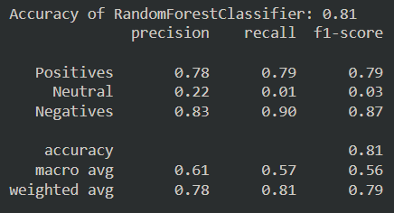
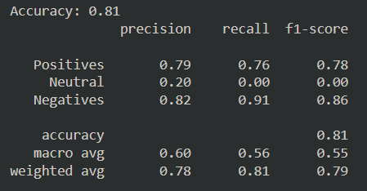
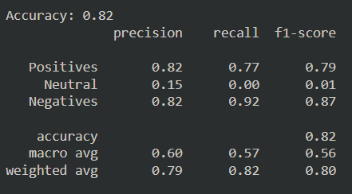
Performance Metrics
Random forest:
Naïve Bayes:
Logistic Regression:
The precision, recall, and F1-score results for the Neutral class clearly indicate that data imbalance has adversely impacted the model's performance.

Slide 15
SMOTE – Handling data imbalance
To address the issue of data imbalance, techniques such as oversampling, undersampling can be applied.
The technique we used is SMOTE ( Synthetic Minority Oversampling ).
generates synthetic samples for the minority class, thereby balancing the class distribution in the training data.
enhancing the robustness and fairness of the model, ensuring that it performs well across all classes and provides more reliable sentiment analysis.

Slide 16
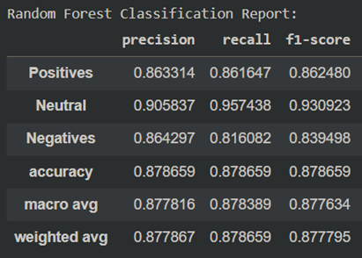
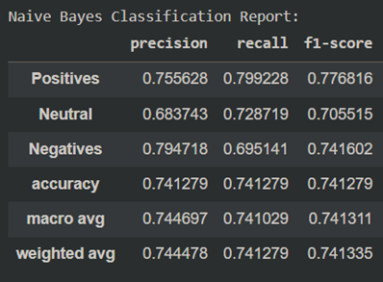
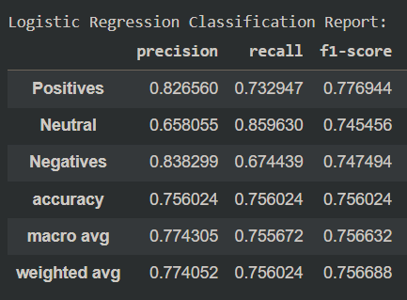
Performance Metrics ( after applying SMOTE )
Random forest:
Naïve Bayes:
Logistic Regression:

Slide 17
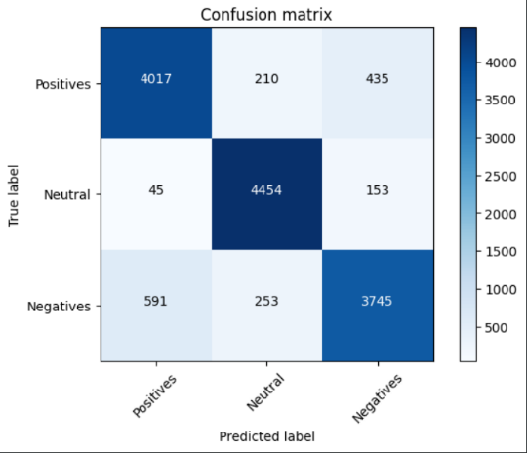
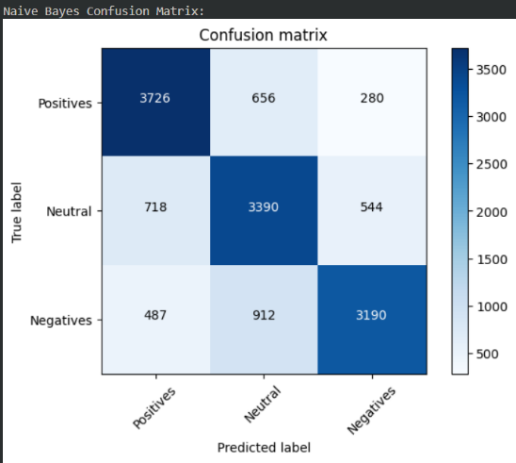
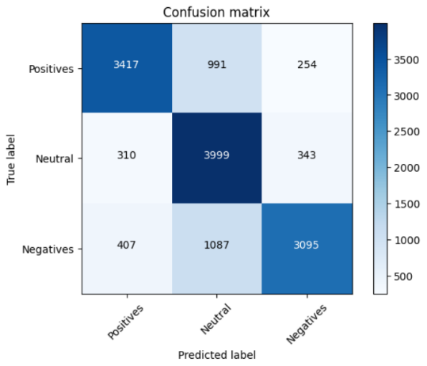
Performance Metrics ( after applying SMOTE )
Random forest:
Naïve Bayes:
Logistic Regression:
Based on the confusion matrices, accuracy and report, we found that the Random Forest model outperformed the other models, achieving higher accuracy and better balance across the classes.

Slide 18
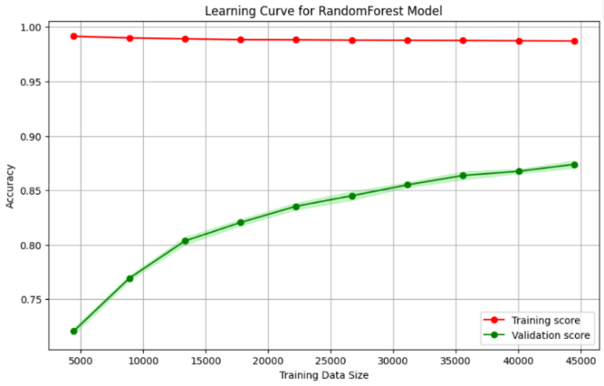
Visualization of Results
Learning curve: The learning curves for the Random Forest model showed how training and validation accuracy evolved as the number of training samples increased.

Slide 19
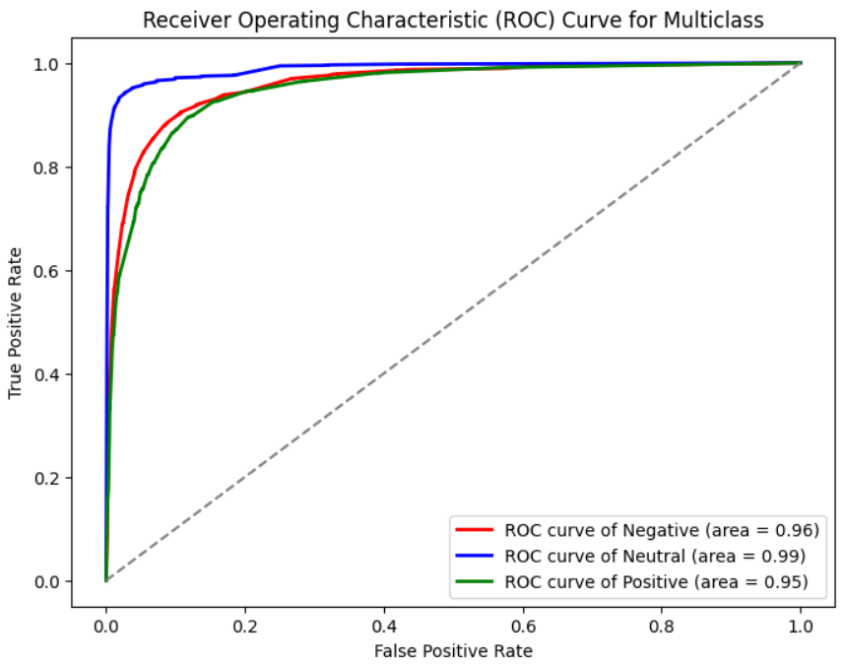
Visualization of Results
ROC Curves: The ROC curves illustrated the trade-off between true positive rate and false positive rate for each class.

Slide 20
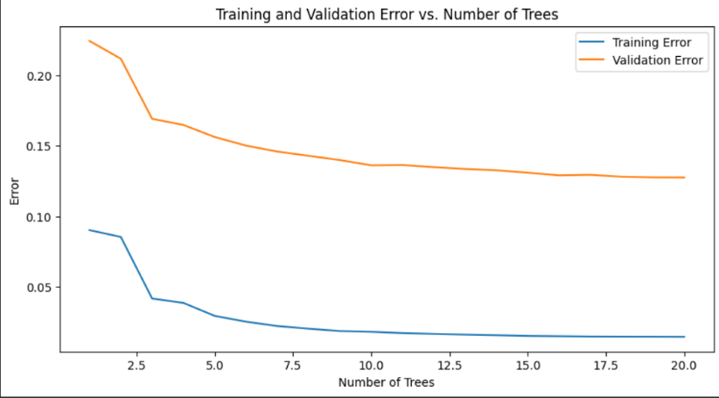
Visualization of Results
Training and Validation Error vs. Number of Trees: plots the error rates on the y-axis against the number of decision trees in the ensemble on the x-axis.

Slide 21
Overall
the use of SMOTE significantly improved the model's ability to handle imbalanced classes.
These results demonstrate the effectiveness of the proposed methodology in addressing sentiment analysis of company reviews and highlight areas for further improvement.
Some testing examples we used:
Comment: "وصلني الطعام متأخرا والاكل بارد" → Predicted Label: Negative
Comment: "أفضل تطبيق" → Predicted Label: Positive
Comment: "مش عارف" → Predicted Label: Neutral

Slide 22
Project Strengths
High Accuracy: The final model achieved an accuracy of 88%, demonstrating its effectiveness in sentiment classification.
Data Imbalance Handling: The use of SMOTE successfully addressed the issue of data imbalance, ensuring that all sentiment classes were adequately represented in the training process.
Comprehensive Preprocessing: The extensive preprocessing pipeline, including emoji removal, punctuation removal, tokenization, stop words removal, stemming, and lemmatization, significantly improved the quality of the input data.
Visualization Tools: The use of visualizations such as word clouds, pie charts, and provided valuable insights into the dataset and the distribution of sentiments and companies.

Slide 23
Limitations
Dialectal Variations: The model struggled with accurately classifying sentiments across different Arabic dialects, which have distinct vocabulary and syntax.
Limited Lexical Resources: The lack of comprehensive Arabic sentiment lexicons posed a challenge in enhancing the model's performance.
Complexity in Preprocessing: The extensive preprocessing required for Arabic text added complexity and increased the processing time.

Slide 24
Future Works
Enhancing Dialect Handling: improving the model's ability to handle various Arabic dialects.
Real-Time Sentiment Analysis: Developing a real-time sentiment analysis application that can process and classify sentiments in live text streams.
Exploring Deep Learning Models: Investigating the use of deep learning models such as BERT or GPT for Arabic sentiment analysis could provide insights into further improving model performance and handling more complex linguistic structures.
Deployment into an Environment: Deploying the model into an environment using frameworks like Flask or Streamlit.

Slide 25



THANK YOU Any Question?

